Slide 1
Introduction to FHIR
Grahame Grieve
July 10, 2014

Slide 2
This presentation
Can be downloaded here:
http://gforge.hl7.org/svn/fhir/trunk/presentations/2014-07 Regenstrief/Introduction to FHIR.pptx
Use “anonymous” and email address to logon
Is licensed for use under the Creative Commons, specifically:
Creative Commons Attribution 3.0 Unported License
(Do with it as you wish, so long as you give credit)

Slide 3
Who am I?
Name: Grahame Grieve
Company: Health Intersections Pty Ltd
Background:
Laboratory Scientist
Diagnostic Systems Vendor
Health Integration / Standards
FHIR Project Lead
Blog: http://healthintersections.com.au

Slide 4
What is FHIR?

Slide 5

Answer: An instigator of bad puns
FHIR is the hottest thing since . . .
This spec is spreading like . . .
Committee X is really on FHIR
Feel free to come up with your own
(but please, not here ☺)

Slide 6
The acronym
F – Fast (to design & to implement)
Relative – No technology can make integration as fast as we’d like
H – Health
That’s why we’re here
I – Interoperable
Ditto
R – Resources
Building blocks – more on these to follow
Notes:
9:25

Slide 7
Genesis of FHIR
Has been a need to share healthcare information electronically for a long time
HL7 v2 is over 25 years old
Increasing pressure to broaden scope of sharing
Across organizations, disciplines, even borders
Mobile & cloud-based applications
Faster – integration in days or weeks, not months or years
Notes:
Who

Slide 8
Genesis of FHIR
Q: So what did HL7 have to offer in this space?
A: Not much
V2 Old, and limited by it’s own rules
V3 too slow and too hard
CDA has success, but both limited and too hard
Different contexts of interoperability → different representations that aren’t compatible
Nothing suitable for light-weight integration, or for Health 2.0

Slide 9

Genesis of FHIR
HL7 undertook a “Fresh look”
What would healthcare exchange look like if we started from scratch using modern approaches?
Web search for success markers led to RESTful based APIs
Exemplar: Highrise (https://github.com/37signals/highrise-api)
Drafted a healthcare exchange API based on this approach

Slide 10
FHIR Development Progress
July 2011 – Conception
Aug/Sept 2012 – First Draft Ballot
Sept 2012 – First Connectathon
Aug/Sept 2013 (now) – First DSTU ballot DSTU = Draft Standard For Trial Use
January 2014 – DSTU finalised
~Mar 2015 – 2nd DSTU
Mid 2016? – Normative Version

Slide 11
FHIR Principles

Slide 12
FHIR Manifesto
Focus on Implementers
Target support for common scenarios
Leverage cross-industry web technologies
Require human readability as base level of interoperability
Make content freely available
Support multiple paradigms & architectures
Demonstrate best practice governance
Notes:
We don’t actually have a formal manifesto, but these are the principles we adhere to.

Slide 13
Implementer Focus
Specification is written for one target audience: implementers
Rationale, modeling approaches, etc. kept elsewhere
Multiple reference implementations from day 1
Publicly available test servers
Starter APIs published with spec
C#, Java, Pascal, ObjectiveC – more to come
Connectathons to verify specification approaches
Instances you can read and understand ☺
Lots of examples (and they’re valid too)
using HL7.Fhir.Instance.Model;
using HL7.Fhir.Instance.Parsers;
using HL7.Fhir.Instance.Support;
XmlReader xr = XmlReader.Create(
new StreamRead
IFhirReader r = new XmlFhirReader
// JsonTextReader jr = new JsonTe
// new StreamRead
// IFhirReader r = new JsonFhirRe
ErrorList errors = new ErrorList(
LabReport rep = (LabReport)Resour
Assert.IsTrue(errors.Count() == 0
Notes:
Who’s read the v3 spec? – modeler & balloter focused
Spec is driven by people who write code
Numerous pieces have been changed because of experience with what worked when trying to implement
Even have a test workbench for RESTful servers

Slide 14
Support “Common” Scenarios
Focus on scenarios implementers ask for
Inclusion of content in core specification is based on core content rule
“We only include data elements if we are confident that most normal implementations using that resource will make use of the element”
Other content in extensions (more on this later)
Easy to say, governance challenge to achieve
Resources are simple and easy to understand and use
Notes:
Design by constraint failed – years to develop, what was produced required yet more design to be implementable and after that might not be interoperable
How to determine the 80%? Look to existing specs – v2, v3, CDA templates, OpenEHR, jurisdictional projects, what implementations we’ve seen
If not sure, err on the side of “not in for now”
Note: not 80% of instances, 80% of implementations
Challenges with “raising the bar”
What happens when there aren’t many/any implementations?

Slide 15
Web technologies
Instances shared using XML & JSON
Collections represented using ATOM
Same technology that gives you your daily news summary
Out-of-the-box publish/subscribe
Web calls work the same way they do for Facebook & Twitter
Rely on HTTPS, OAuth, etc. for security functions
http://...
Notes:
We try very hard to *not* invent stuff that exists elsewhere unless it’s really broken or totally unaligned with the FHIR principles.

Slide 16

Human Readable
Clinical Documents has both narrative and data
The data / narrative dynamic exists throughout the process
In FHIR, every resource is required to have a human-readable expression
Can be direct rendering or human entered
Notes:
Even when you think your target will understand all the encoded data, reality is data often gets shared beyond the originally intended context
Allow for exceptions for things like automated device readings, etc.

Slide 17
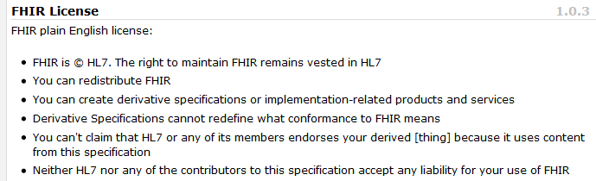
Freely available
Unencumbered – free for use, no membership required
http://hl7.org/fhir
Notes:
Was a bigger deal before HL7 decided to open up all IP
full legal text towards bottom of FHIR home page

Slide 18
FHIR & Cost of Integration
These factors will drive down the cost of integration and interoperability
Easier to Develop
Easier to Troubleshoot
Easier to Leverage in production
More people to do the work (less expensive consultants)
Competing approaches will have to match the cost, or disappear – effect is already being felt

Slide 19
Future impact of FHIR
Impact of FHIR on the market:
Drive interoperability prices down
Higher Expectations
Increased spend on integration (N x 2!)
Overall Market focus
PHR on the web
Healthcare repositories (MHD+)
Device Data management
Retooling existing connections
Notes:
How much integration do you need? Nx2 – twice what you have

Slide 20
About REST and Resources

Slide 21
REST
“Representational state transfer” – an architecture for how to connect systems
Outcomes
Simple stable interfaces
High Performance / Scalability
Visible Process (e.g. can debug)
Portability
Reliability (resistance to failure)

Slide 22
REST in practice
“Resources” with an explicit and stable URI
The name for what gets exchanged in REST
Defined behaviour and meaning
Known identity / location
Quite an abstract idea
Formats: XML / JSON / RDF
Exchange using HTTP
Security: SSL / OAuth
“REST” followed loosely, hence “RESTful”

Slide 23
REST Operations
CRUD(E):
Create – create a new instance of data
Read – get the content (state) of an instance of data
Update – change the content of an instance of data
Delete – remove the instance of data
Execute – get the instance of data (?) to do something for you
Notes:
Delete isn’t necessarily physical

Slide 24
RPC vs REST
RPC (Remote Procedure Call):
Ask a server to perform some operation
Hand it a set of parameters
Server performs some operations
Returns a set of parameters
REST:
Define a URI that represents the state of something
Tell the server what the state should be
Server makes the state change happen

Slide 25
RPC vs REST example
Example:
A device that monitors a patient %0₂ Sat
Raises an alarm on EHR if it’s too low
EHR can turn the alarm off
RPC:
POST http://acme.org/devices/turnOffAlarm
Parameters: device id, alarm id
REST:
POST http://acme.org/devices/[deviceid]/[alarmid]
Content: data to say “Alarm is off”

Slide 26
RPC vs REST
Difference is subtle, and depends on perspective
Outcome is large difference
REST is increasingly preferred in practice
Most systems mix and match
“mini-operations”
General issue: REST doesn’t deal well if server needs context from the client
Needed for poorly trusted clients

Slide 27
Paradigms
FHIR supports 4 interoperability paradigms
REST
Documents
Messages
Services

Slide 28
Documents
Similar to CDA
Collection of resources bound together
Root is a “Composition” resource
Just like CDA header
Sent as an ATOM feed
One context
Can be signed, authenticated, etc.
Documents

Slide 29
Messages
Similar to v2 and v3 messaging
Also a collection of resources as an ATOM feed
Allows request/response behavior with bundles for both request and response
Event-driven
E.g. Send lab order, get back result
Can be asynchronous
Messages

Slide 30
Service Oriented Architecture (SOA)
Do whatever you like
(based on SOA principles)
Ultra complex workflows
Ultra simple workflows
Individual resources or collections (in Atom or other formats)
Use HTTP or use something else
Only constraint is that you’re passing around FHIR resources in some shape or manner
Services
Notes:
Comment about SOA discovery day

Slide 31
Paradigms
Regardless of paradigm the content is the same
This means it’s straight-forward to share content across paradigms
E.g. Receive a lab result in a message. Package it in a discharge summary document
It also means constraints can be shared across paradigms
E.g. Define a profile for Blood Pressure and use it on resources in messages, documents, REST and services

Slide 32
FHIR Resources
Notes:
10:00

Slide 33

Resources
“Resources” are:
Small logically discrete units of exchange
Defined behaviour and meaning
Known identity / location
Smallest unit of transaction
“of interest” to healthcare
V2: Sort of like Segments
V3: Sort of like CMETs

Slide 34
What’s a Resource?
Examples
Non-examples
Administrative
Patient, Practitioner, Organization, Location, Coverage, Invoice
Clinical Concepts
Allergy, Condition, Family History, Care Plan
Infrastructure
Document, Message, Profile, Conformance
Gender
Too small
Electronic Health Record
Too big
Blood Pressure
Too specific
Intervention
Too broad
100-150 total
Notes:
And few systems will ever see more than 40-50

Slide 35
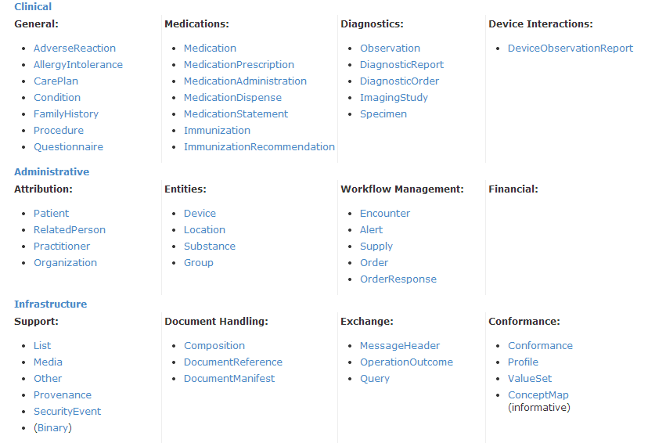
DSTU Resource List

Slide 36
Resource anatomy
Resources have 3 parts
Extensions
Narrative
Defined
Structured
Data
Notes:
Defined Structured Data
The logical, common contents of the resource
Mapped to formal definitions/RIM & other formats
Extensions
“Non-common” requirements, but everyone can use
Published and managed
Narrative
Human readable (fall back)

Slide 37
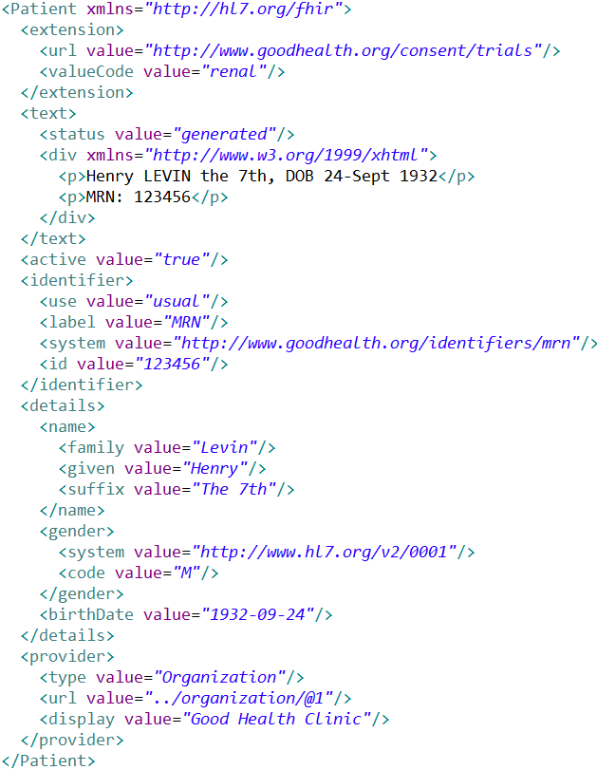
Extension with reference to its definition
Human Readable Summary
Standard Data Content:
MRN
Name
Gender
Date of Birth
Provider
Notes:
System for gender is wrong . . .

Slide 38
Resource Documentation
For each Resource:
Scope and Usage Notes
Resource Content (UML and XML)
Terminology Bindings
Constraints
Implementation Issues
Search Parameters
Examples, Profiles, Formal Definitions
Mappings to RIM, CDA, v2, etc

Slide 39
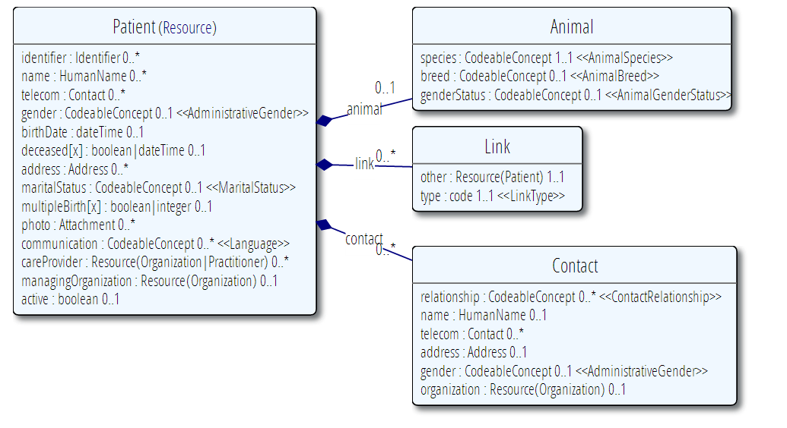
Example Resource Definitions

Slide 40
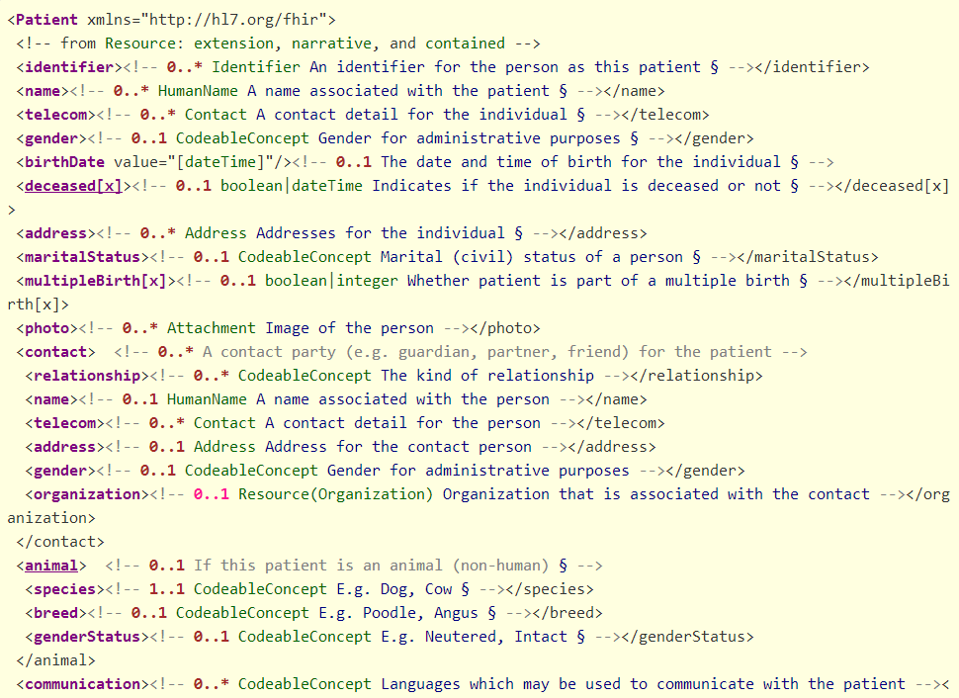

Slide 41
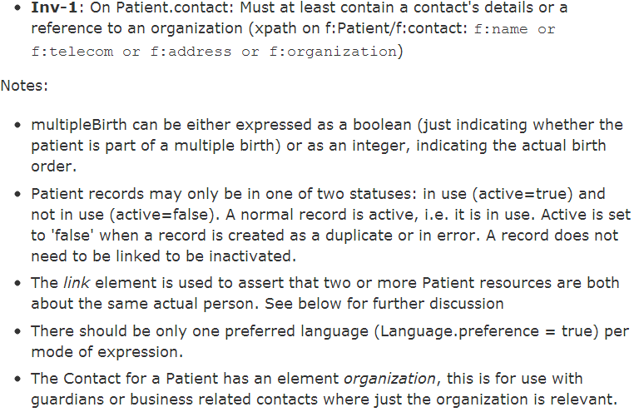
Constraints & Notes

Slide 42
Resource elements
Resources are defined as an XML structure based on desired wire syntax
Hierarchy of elements
Each element has
Name
Either a datatype or nested elements
Cardinality
All collections are nested in a containing element
Definition
Mappings
But instances in XML or JSON

Slide 43
It’s all about the resources . . .
Location
Lab
Report
Related
Person
Patient
Practitioner
Notes:
Steve ballmer – It’s all about the developers

Slide 44
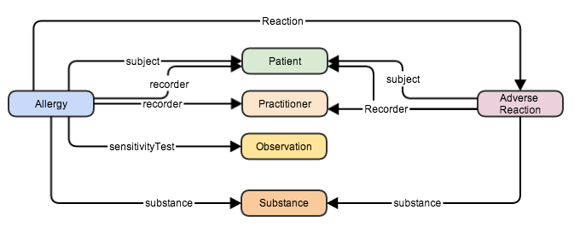
References between resources

Slide 45
References
Resources are independent – don’t need to other resources to correctly interpret a resource
But resources reference each other extensively to form a web of information
Need to resolve references to fully understand the data
Reference is relative to server base URL
<Procedure xmlns="http://hl7.org/fhir">
<subject>
<reference value="Patient/23"/>
</subject>
…

Slide 46
Rules for references
References can be relative or absolute
References don’t have to be to the same server
Server does not have to enforce integrity
Clients need to cater for broken links
Targets can be ‘contained’ in the resource:
<Procedure xmlns="http://hl7.org/fhir">
<contained>
<Patient id="pat">
</Patient>
</contained>
<subject>
<reference value="#pat"/>
</subject>

Slide 47
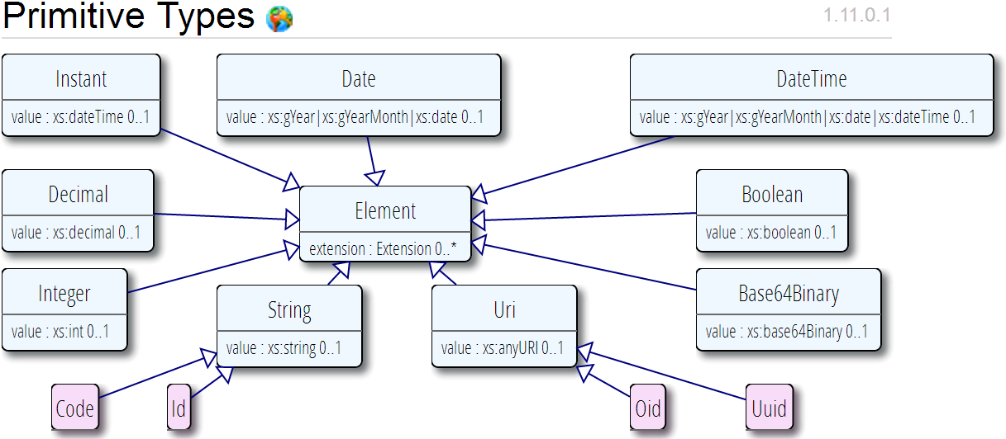
Data types
Based on w3c schema and ISO data types
Stick to the “80% rule” – only expose what most will use

Slide 48
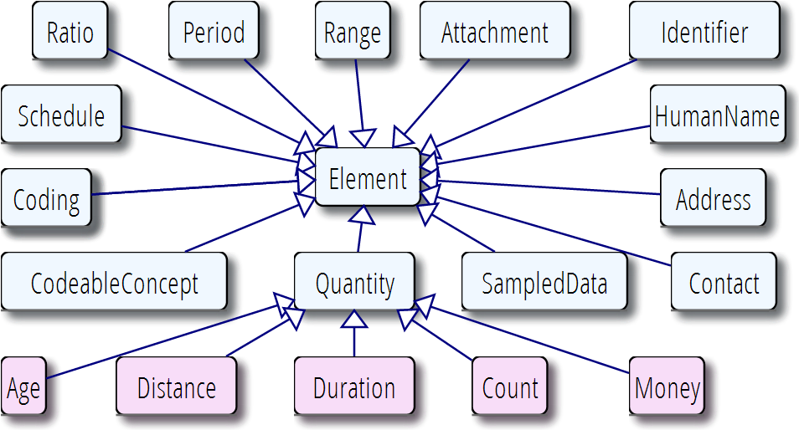
Data types (cont’d)

Slide 49
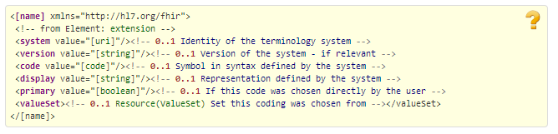

CodeableConcept

Slide 50
Vocabulary
Support for coded data of varying complexity
Some codes defined as part of resource, others referenced from external vocabularies
LOINC, SNOMED, UCUM, etc.
Recognition some will differ by implementation space
Can use Value Set resource to define more complex code lists

Slide 51
Bundles
When more than one resource needed
Query result
Document
Message
Atom ‘feed’
With JSON representation

Slide 52
Narrative
All resources carry an html representation of their content
It’s a clinical safety issue
The receiver has a fall back option if the system is not sure it fully understands the content
It is not mandatory, but SHOULD be present
In a closed eco-system, with extremely tight control and strong conformance testing, it may not be necessary
But things often change over time
So using narrative is highly recommended
Saves a lot of money downstream from the author

Slide 53
Narrative XHTML
Narrative is XHTML. Formatting allowed:
Tables, lists, divs, spans
Bold, Italics, styles etc
E.g. all static content
Features not allowed:
Objects, scripts, forms – any active content
Links, Stylesheets, iframes – web context
Local storage, Microdata (no active content)
Concerns are security and clinical safety

Slide 54
FHIR Extensions
Notes:
10:15

Slide 55
The Case for Extensions
Extensions are often problematic in existing HL7 specs
Z-segments in v2
What does this mean?
ZSB|20080117|Q^57|4.30^uL
Foreign namespaces in CDA/V3
Break schemas
Simple choice – design for absolutely everything or allow extensions

Slide 56
Extensions
FHIR has a standard framework for extensions
Every FHIR element can be extended
Every extension has:
Reference to a computable definition
Value – from a set of known types
Every system can read, write, store and exchange all legal extensions
All extensions are valid by schema etc.

Slide 57
Extensions without the pain…
Extensions are built into the wire format
All conformant systems can “handle” any possible extension - Just a bucket of “other stuff”
Extensions rendered in human readable portion
Notes:
Recipient must be able to know about these in the instance
Avoid modifier extensions -

Slide 58
Governing Extensions
Extensions are not a silver bullet
FHIR has a sliding scale governance for extensions
Local Projects
Domain standards (e.g. Best Practice Cardiology)
National Standards (e.g. Standard Finnish Extensions)
HL7 published extensions (corner cases with international scope)

Slide 59
Example – CD datatype
ISO
Code, code system, code system name, code system version, value set id, value set version, coding rationale, updateMode, flavorId, nullFlavor, controlAct root & extension, validTime low and high
displayName with language and translations
originalText with mediaType, language, compression, integrityCheck, thumbnail, description, translations, reference (can be text, video, whatever)
Translations (most of same info as code)
Source code

Slide 60
Example – CD datatype
FHIR
Code, code system, code system name, code system version, value set id, value set version coding rationale, updateMode, flavorId, nullFlavor, controlAct root & extension, validTime low and high
displayName with language and translations
originalText with mediaType, language, compression, integrityCheck, thumbnail, description, translations, reference (can be text, video, whatever)
Translations (most of same info as code)
Source code

Slide 61
What’s the goal here?
In most areas of healthcare standards, there is wide variability
Between systems, countries, institutions, clinicians
Choices:
Specification only supports core – no one can use it
Specification adds everything – no one understands it
Specification picks winners – only they can use it
Allow extensions that people can use
Extensions tame the specification

Slide 62
Example Extension
Eye Colour to patient resource:
Need to pick a URL
Need to choose a type
Have to declare and publish the extension (at the URL)
<Patient xmlns="http://hl7.org/fhir">
<extension url="http://acme.org/fhir/patient#eyecolor">
<valueCode value="brown"/>
</extension>
…

Slide 63
Publishing an Extension
Field | Value
Context | The patient resource
Name | Eye Colour
Definition | Eye Colour as chosen by clerical staff based on visual inspection
Requirements | Refer to policy 23B section A.1.2.3
Cardinality | 0..1
Type | String
Binding | Codes: blue, brown, green, mixed, violet
Modifier | false
Constraints
Mappings | .

Slide 64
FHIR Operations

Slide 65
Business Operations
Register a patient:
Create a Patient Resource
Admit a patient:
Create an Encounter Resource
Move a patient from one bed to another
Find and update the encounter resource
Prepare a list of medications to administer
Search through the medication prescriptions for a patient (and then apply logic)

Slide 66
FHIR Resource URLs
Template | Description | Example
[base] | Server URL | http://fhir.com
[base]/[type] | URL for type manager | http://fhir.com/Patient
[base]/[type]/[id] | URL for a resource | http://fhir.com/Patient/23
[base]/[type]/[id]/_history/[vid] | URL for a past version of a resource | http://fhir.com/Patient/23/_histroy/2

Slide 67
Operations / Instance
Op | Description | Request Content | Response Content
read | Read the current state of the resource | -- | Resource
vread | Read the state of a specific version of the resource (e.g. what it was in the past) | -- | Resource
update | Update an existing resource by its id (or create it if it is new). Use the resource representation supplied | Resource | --
delete | Remove the resource so it is no longer present (note: it still has a history) | -- | --
history | Get a list of all the past versions of the resource | -- | Atom feed

Slide 68
Operations / Type
Op | Description | Request Content | Response Content
create | Create a new resource with a server assigned id | Resource | --
search | Search through all resources of the type based on some filter criteria | Params | Atom Feed
history | Get a list of all the past versions of this resource type | -- | Atom Feed
validate | Check that the content would be acceptable as an update | Resource | Resource (OperationOutcome)

Slide 69
Operations / System
Op | Description | Request Content | Response Content
conformance | Get a conformance statement for the system | -- | Resource
transaction | Update, create or delete a set of resources as a single transaction | Atom Feed | Atom Feed
history | Retrieve the update history for all resources (full pub/sub) | -- | Atom Feed
search | Search through all resources of all types based on some filter criteria | Params | Atom Feeds

Slide 70
Profiles & conformance
Notes:
10:15

Slide 71
Conformance Resources
Conformance – a state of system capabilities
Profile – a set of rules about a resource is used
Value set – describes a set of codes that can be used for something

Slide 72
Conformance
There’s a resource for documenting conformance to FHIR
Can be used for:
Stating how a specific system instance behaves
Defining how a software system is capable of behaving (including configuration options)
Identifying a desired set of behavior (e.g. RFP)
To declare themselves “FHIR Conformant”, a system must publish a Conformance instance
Notes:
Doesn’t have to support XML – is can be json only

Slide 73
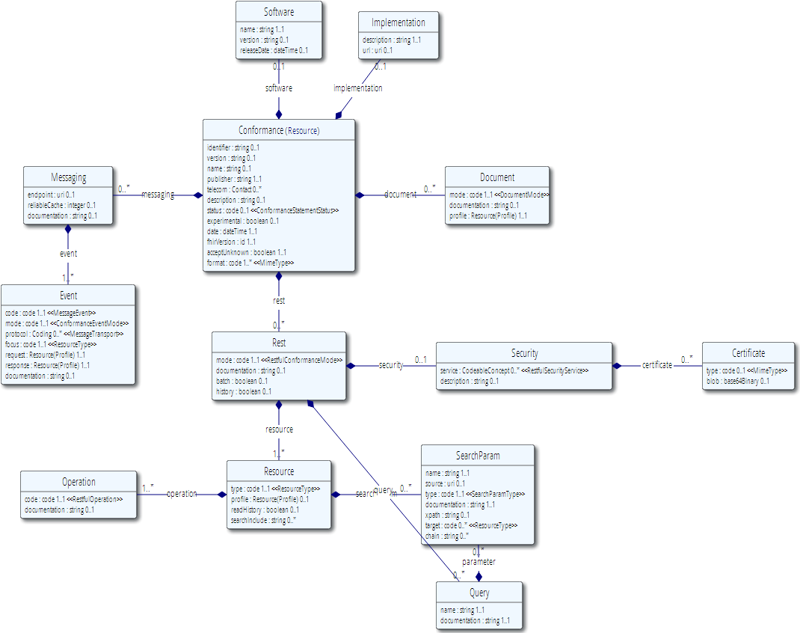
Conformance (cont’d)

Slide 74
Profiles
Document constraints and extensions on one or more resources
May also define new extensions search terms, new messaging events, etc.
Subsumes: template, implementation profile, DCM (Detailed Clinical Model), etc.
Looks an awful lot like the definition of the resources themselves
You can download profile XML for all resources
Notes:
Extensions and profiles are a big part of spec – Wednesday Q2 for specific session

Slide 75
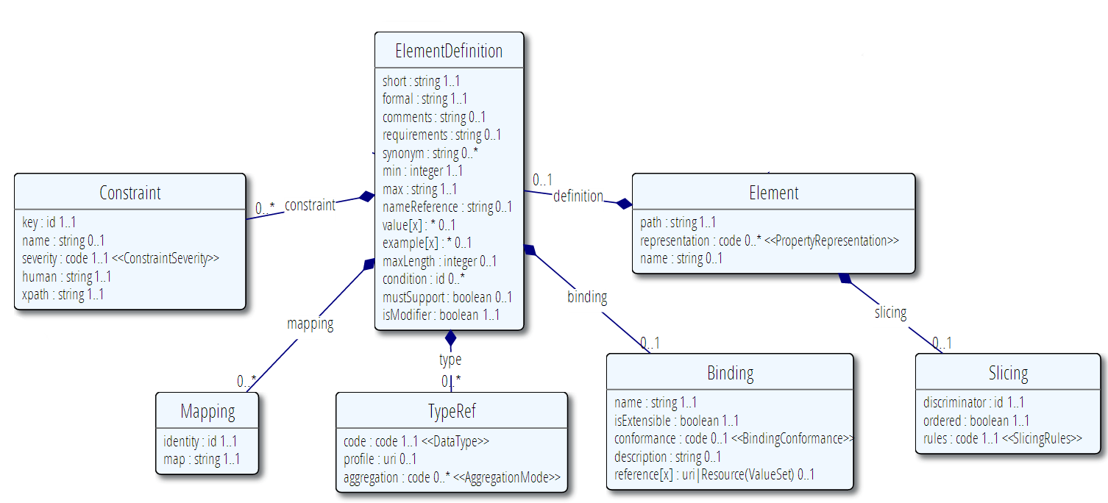
Profile (cont’d)

Slide 76
Using Profiles
You can just go ahead and use a resource
No need for a profile
But you can write a profile
Document your usage in detail for partners
You can mark a resource with a profile
It’s just a claim – can test conformance with that
Denormalization for performance

Slide 77
Implementing FHIR

Slide 78
Where can FHIR be used?
Classic in-institution interoperability
Back-end e-business systems (e.g. financial)
Regional Health Information Organizations (RHIO)
National EHR systems
Social Web (Health)
Mobile Applications
Near
Term

Slide 79
Architecture
Standalone FHIR Server
A FHIR Server in front of an existing application (e.g. SQL)
FHIR as front end to an XDS server (“MHD”)
An interface engine that ‘speaks’ FHIR
A tablet/mobile phone application
Web portal uses FHIR to access other systems
A healthcare application that access information from multiple systems as well as it’s own server
Smart-On-FHIR – an EHR plug-in framework

Slide 80
Implementation Assistance
Reference Implementations – object models, parsers, serializers, clients, validators, utilities
Schema, Schematron, Validation Pack
1000’s of examples
Live Servers to test against
http://wiki.hl7.org/index.php?title=Publicly_Available_FHIR_Servers_for_testing
Connectathons

Slide 81
Servers
Use the servers to explore how it works
Write clients that use the test data
Test that you got your own system right
Most developers:
use the servers to learn
consult the documentation occasionally
I do recommend to read the specification a little

Slide 82
Other Free software
See http://wiki.hl7.org/index.php?title=Open_Source_FHIR_implementations
Coming shortly:
“Sprinkler” – a conformance test tool for servers
“Forge” – an editor for conformance statements
A Value set Editor
Several implementation guide publishers

Slide 83
Connectathons
Open invitation to any interested party to come and write software that exchanges FHIR resources
Always hold one before HL7 meetings (last week) + Others by invitation
Mix of skills
Newbies (“where is the spec?”)
Old hands who’ve been to every connectathon
Experiment with new features
We have a virtual connectathon all the time…

Slide 84
Implementation Assistance
Stack Overflow – ask implementation questions
Link from front page
Search for answers first
Don’t ask for changes to the spec (get deleted!)
gForge Tracker – ask for changes to the spec
Link from bottom of every page
But have discussion somewhere first
Disqus – on every page of the specification
Skype – implementers channel – 105 participants
FHIR Email list, Connectathons, Tutorials

Slide 85
Migration
No expectation that people will migrate existing interfaces any time soon.
Initial adopters will be green-field, new technology
FHIR may see use behind the scenes in v2 systems before it sees use over the wire
Forthcoming policy initiatives may necessitate revisiting existing interfaces

Slide 86
Migration – v2
Already have an integration engine that supports translation between v2 and FHIR
Resources map to segments reasonably well
As always, the challenge with v2 mapping is the variability of v2 interfaces
“Common” mappings can be created, but they won’t be one size fits all

Slide 87
Migration – CDA
Made more complex by human-readable nature
Need to ensure text <-> entry linkages are retained
Will best be handled on a template by template basis
Likely start with important ones like C-CDA
Notes:
12:15
Text linkages not as important when not human-attested

Slide 88
FHIR Manifesto
Focus on Implementers
Target support for common scenarios
Leverage cross-industry web technologies
Require human readability as base level of interoperability
Make content freely available
Support multiple paradigms & architectures
Demonstrate best practice governance

